Slide 1
Mean shift based tracking using multiple cameras
Real-Time Tracking of Non-Rigid Objects using Mean Shift Dorin Comaniciu, Visvanathan Ramesh, Peter Meer

Slide 2
Introduction
Mean Shift Algorithm
Tracks objects by
Finding similar color distribution
Bhattacharyya coefficient
Calculates most probable location object moved
Multi Camera Fusion

Slide 3
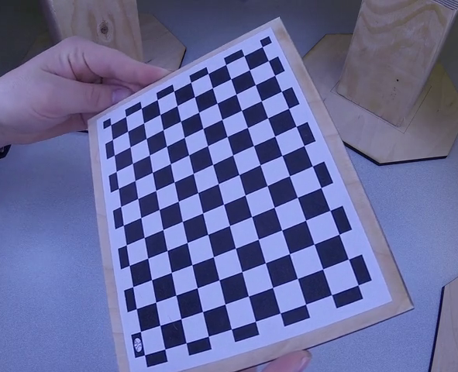
Single Camera Calibration
Used recorded checkerboard images from each camera to calibrate
Finds each corner of the square
Calculates distortion and uses calculation to undistort images

Slide 4
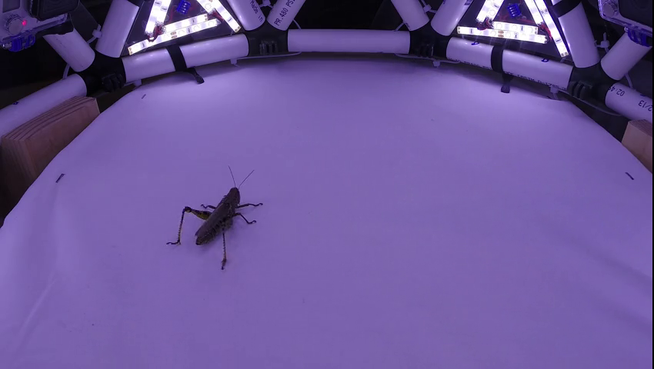
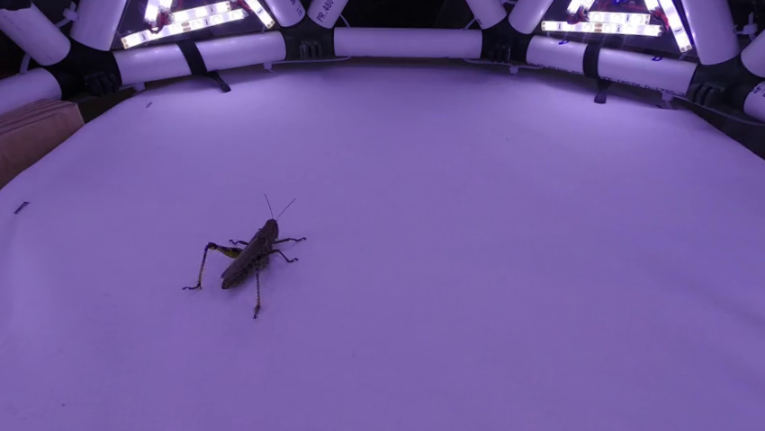
Single Camera Calibration

Slide 5
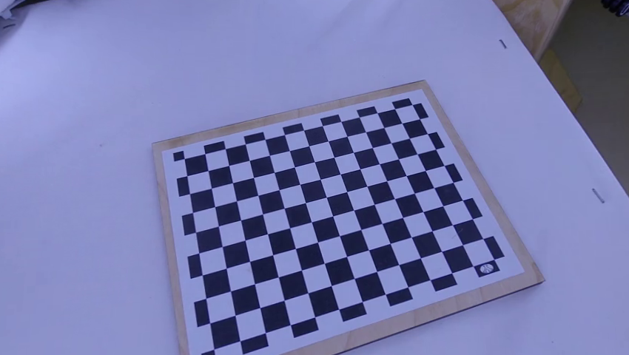
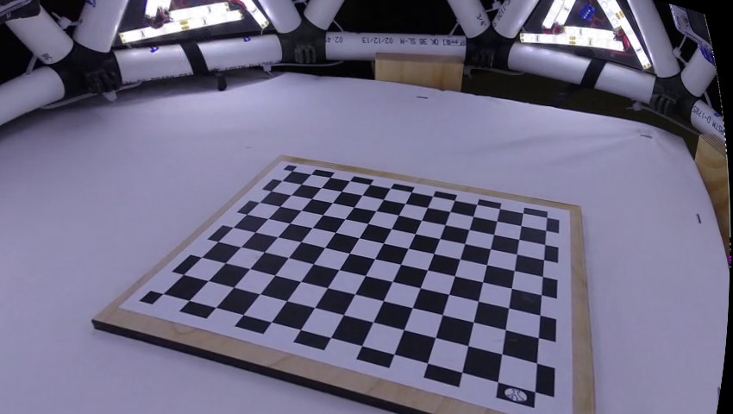
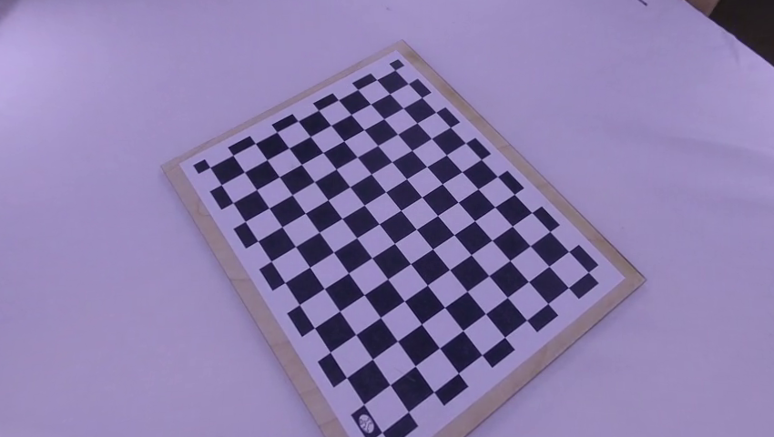
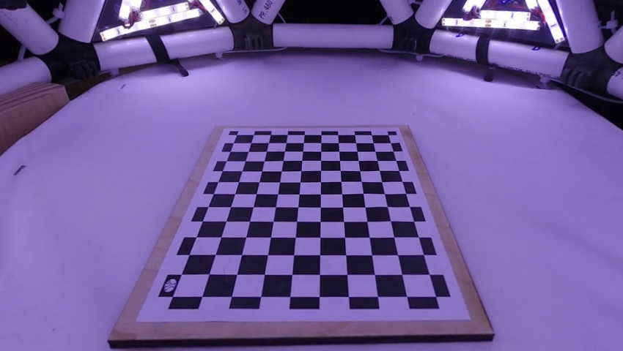
Multi Camera Calibration
First camera is point of reference
Find common points between each camera
Use those points to calculate essential matrix each camera with the first one

Slide 6
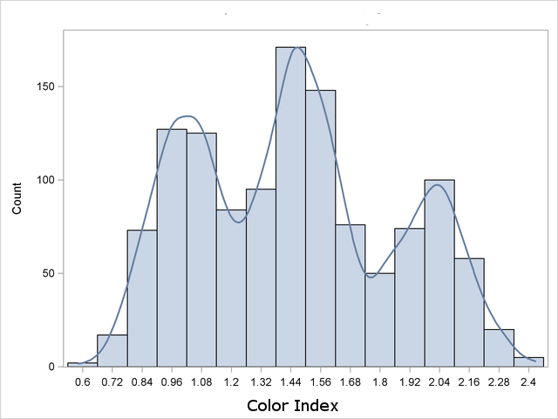

Mean shift object tracking
Kernel density estimate
Tracking window
Color histogram

Slide 7

Mean shift object tracking
Measure distribution similarity
Bhattacharyya coefficient
Maximize similarity
Gradient ascent

Slide 8

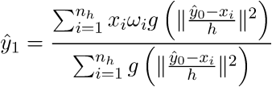
Mean shift object tracking
Compute candidate model at y(k)
Compute weight
Update location to have y(k+1)
Repeat till converge

Slide 9
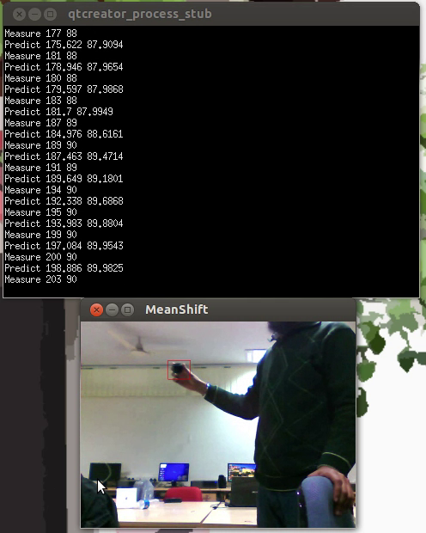
Mean shift object tracking
Color-histogram based feature
Gradient ascent search
Local convex assumption
Local optimization

Slide 10
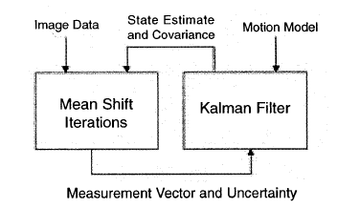
Integrate with Kalman Filter
Increase robustness
Unobservable state estimation

Slide 11
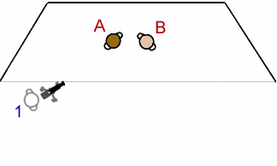
Multiple cameras
One fixed camera is usually not enough
Importing more cameras

Slide 12
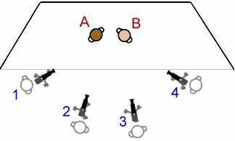
Multiple cameras
More views
Better coverage
More information

Slide 13
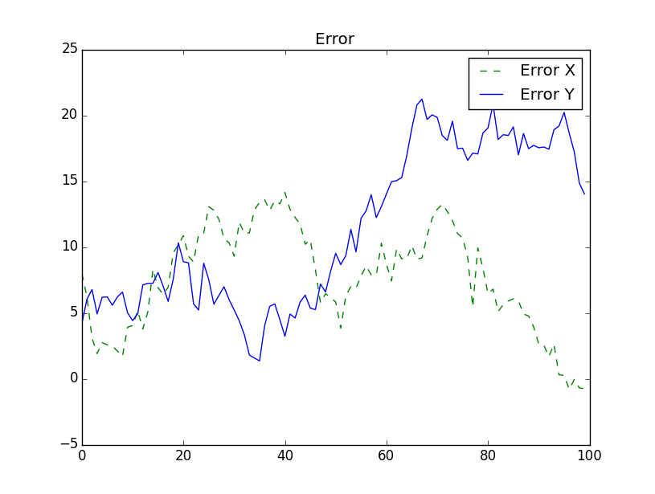
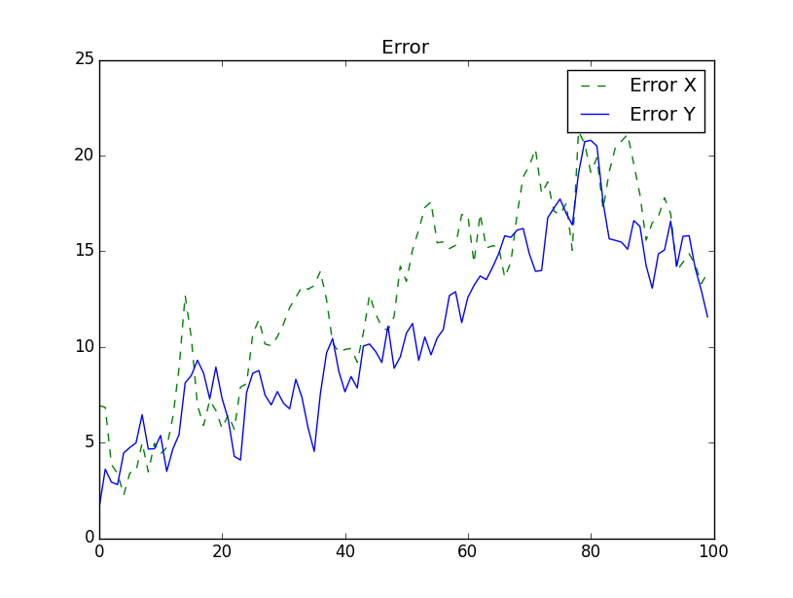
Data fusion
Particle filter
Nonlinear model
One camera
Four camera

Slide 14
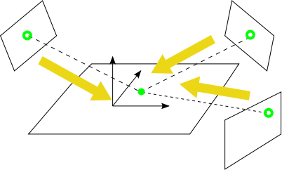
Data fusion
Motion Reconstruction
Observation model -
3D world -> 2D image
2D plane -> 2D image

Slide 15
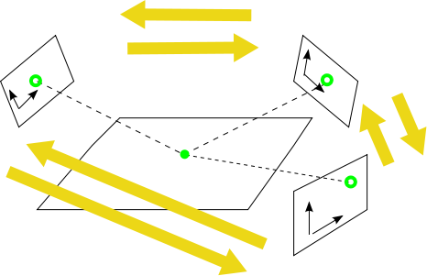
Data fusion
Information exchange
Observation model
2D image -> 2D image

Slide 16
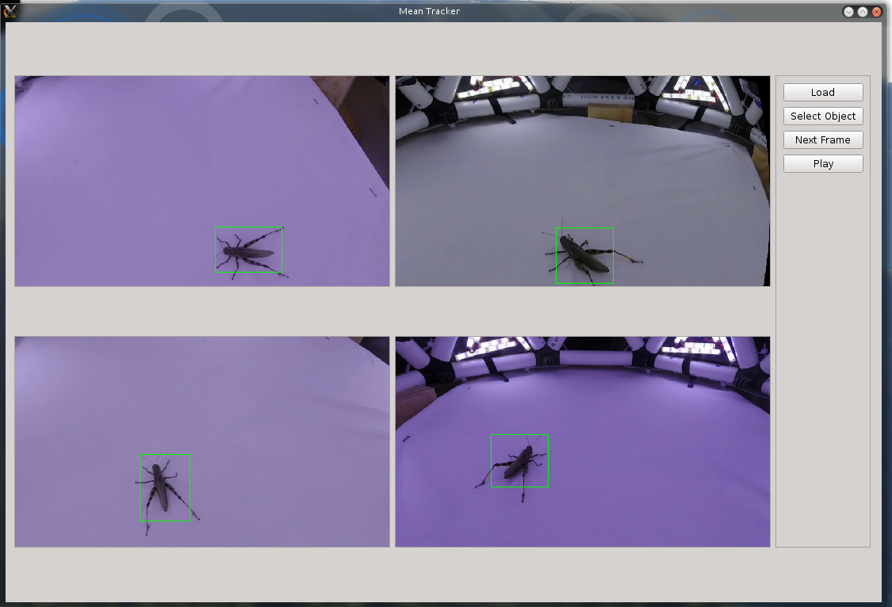
User Interface
QT and OpenCV as base
Videos loaded using a JSON file that holds information for each video
File for each video
Syncing frame number
Calibration for each video
All four videos show at once
User is able to select a box around the object within each video.
This object is followed with each successive frame

Slide 17
Conclusion
Single camera calibration
Mean shift
Multi-camera calibration
Could produce a rotation and translation of the cameras, but difficult to merge together
Data Fusion

